Slide 1


Slide 2

CONTENTS
INTRODUCTION
TYPES OF CYBER CRIME
PREVENTION
CONCLUSION

Slide 3
WHAT IS CYBER CRIME?
Cyber crime is defined as a crime where a computer is the object of the crime or is used as a tool to commit an offense.
Cyber crime is committed by cybercriminals or hackers who want to make money. It is carried out by individuals or organisations.

Slide 4
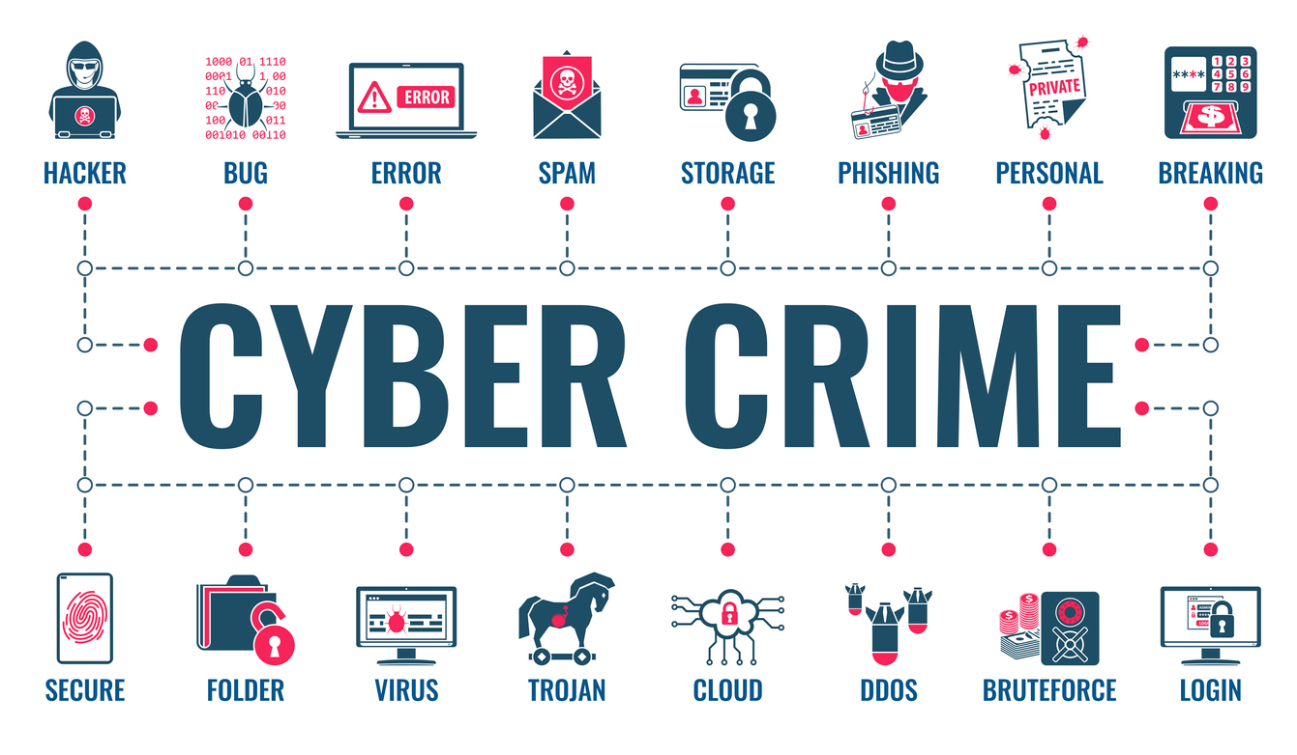
TYPES OF CYBER CRIME
1.HACKING
2.CYBER BULLYING
3.CYBER TERRORISM
4.SOFTWARE PIRACY
5.PHISHING
6.IDENTITY THEFT
7.DENIAL OF SERVICES (DOS)ATTACK
8.VISHING

Slide 5
HACKING
Hacking in simple terms means an illegal intrusion into a computer system and network.
Hacking is the act of compromising digital devices and networks through unauthorized access to an account or computer system. Hacking is not always a malicious act, but it is most commonly associated with illegal activity or data theft by cyber criminals.

Slide 6
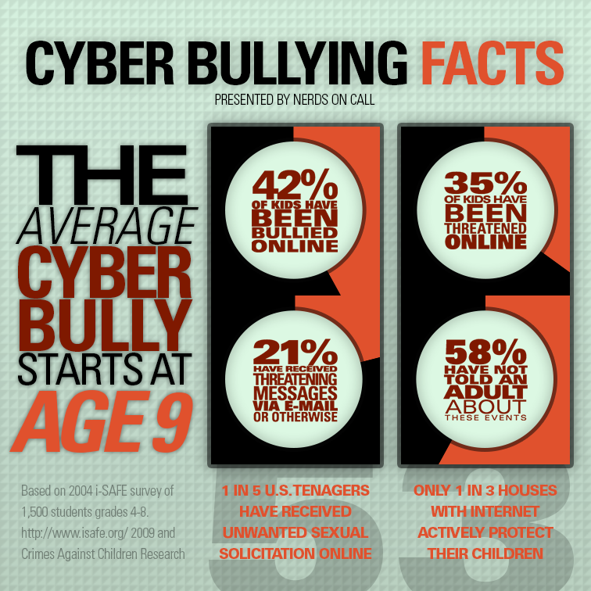
CYBER BULLYING
Cyber bullying is known as online or internet bullying . It includes sending or sharing harmful and humiliating content about someone else which causes embarrassment and can be a reason for the occurrence of psychological problems.

Slide 7
CYBER TERRORISM
Cyber terrorism is the use of the internet to conduct violence acts that result in , or threaten ,loss of life or significant bodily harm ,in order to achieve political or ideological gains through threat or intimidation.
Use of internet based attacks in terrorist activities.

Slide 8
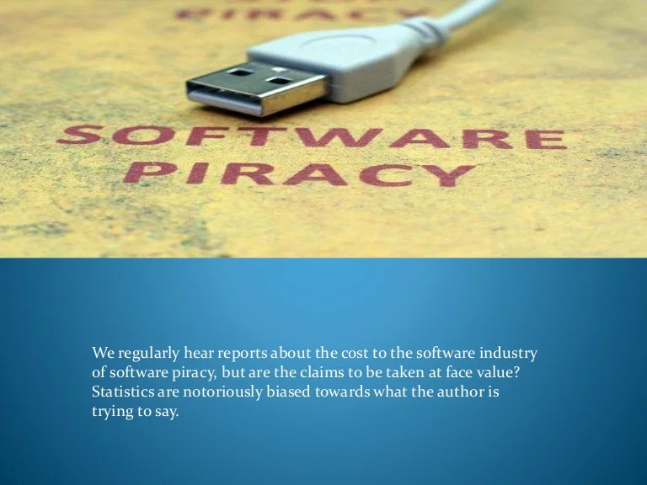
SOFTWARE PIRACY
Software piracy is a term used to describe the act of illegally using ,copying or distributing software without ownership or legal rights .The majority of software today is purchased as a single- user license, meaning that only one computer may have that software installed on it at one time

Slide 9
PHISHING
Phishing is a type of fraud that involves stealing personal information such as customer id , credit/debit card number ,card expiry date , CVV number ,etc. through emails that appear to be from a legitimate source .
Criminals who use phishing tactics are successful because they carefully hide behind emails and websites familiar to intended victim.

Slide 10

TYPES OF PHISHING
CEO FRAUD
FAKE WEBSITES
MOBILE PHISHING
SPEAR PHISHING
VOICE PHISHING
SESSION HIJACKING
MALVERTISING
MALWARE
EVIL TWIN WI-FI

Slide 11

PREVENTION
Use antivirus software’s
Insert firewalls
Uninstall unnecessary software
Maintain backup
Check security settings
Never give your full name or address to strangers.
Learn more about internet privacy.
Do not open links whose source is unknown.

Slide 12

CONCLUSION:
Cyber crime is indeed getting the recognition it deserves .However ,It is not going to restricted easily .In fact, it is highly likely that cyber crime and its hackers will continue developing and upgrading to stay ahead of the law

Slide 13

PRESENTED BY:
JASPINDER KAUR WALIA

